Slide 1

WELLCOME TO
MY PRESENTATION

Slide 2


STUDENT OF PSTU
Name: Abul Basar
ID:2102036
Faculty of computer science and engineering

Slide 3
LEVEL ONE SEMISTER ONE
COURSE AND CODE
1
CCE-112
6
CHE-111
2
CIT-111
7
CHE-112
3
CIT-112
8
EEE-111
4
PHY-111
9
EEE-112
5
PHY-112
10
ME-111

Slide 4

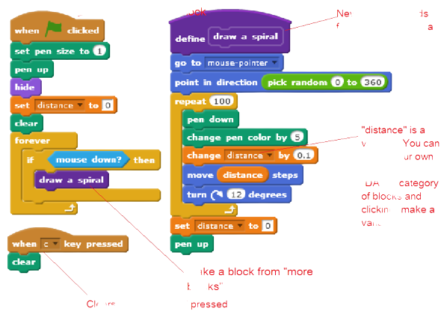
COURSE DETAIL
1
CCE-112
CCE 112 Engineering Drawing 0.75 Course Content:3.00 Introduction, Scale drawing, Sectional views, Isometric views. Missing line, Auxiliary view, Detail and assembly drawing. Project on Engineering Drawing and CAD using contemporary packages.
Reference Books 1. Wiley : Mastering AutoCAD 2008 and AutoCAD LT 2008. 2. M. Groover and E. Zimmers : Computer Aided Design and manufacturing. 3. S. Narayanan: CAD/CAM Robotics and Factories of the Future. 4. Tien Chien Chang: Computer Aided Manufacturing. 5. www.blender.org [To perform blender based project in the light of engineering drawing]

Slide 5
2
CIT-111
CIT 111 Computer Fundamentals and Programming with C/C++ 3 Hrs. per week 3 Credits. Computer Generations and Classification, Data representation, Hardware Components, Software Components, Operating Systems, Computers and Communications. Programming concepts; Structured programming language: data types, variables, operators, type of expressions, control structures; Functions and program structures: function basics, parameter passing conventions, scope rules and storage classes, recursion; Header files; Preprocessor; Arrays, String and Pointers; User defined data type: structures, unions, enumeration; Input and output: standard input and output, formatted input and output, file access; Dynamic memory allocation, Variable length argument list; Command line parameters; Error handling; Introduction to Graphics routines.

Slide 6
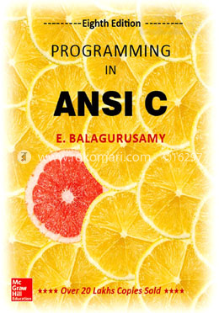
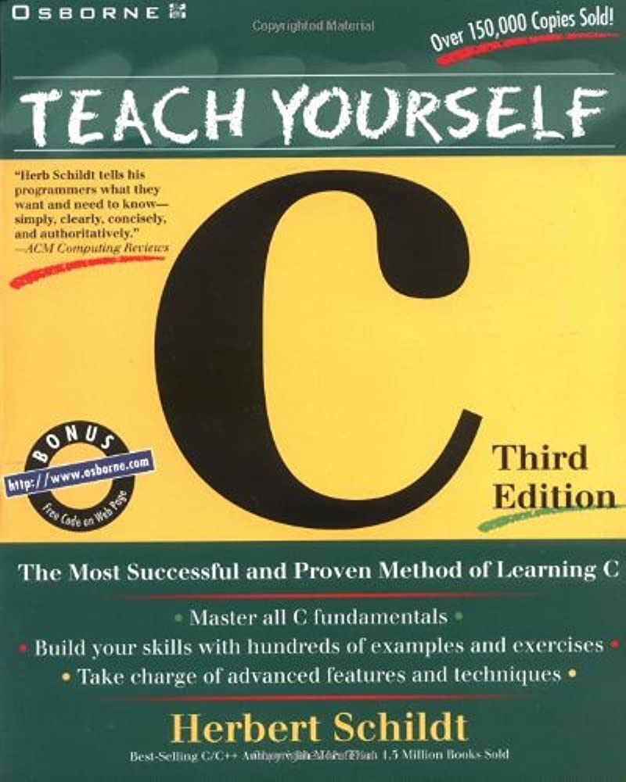
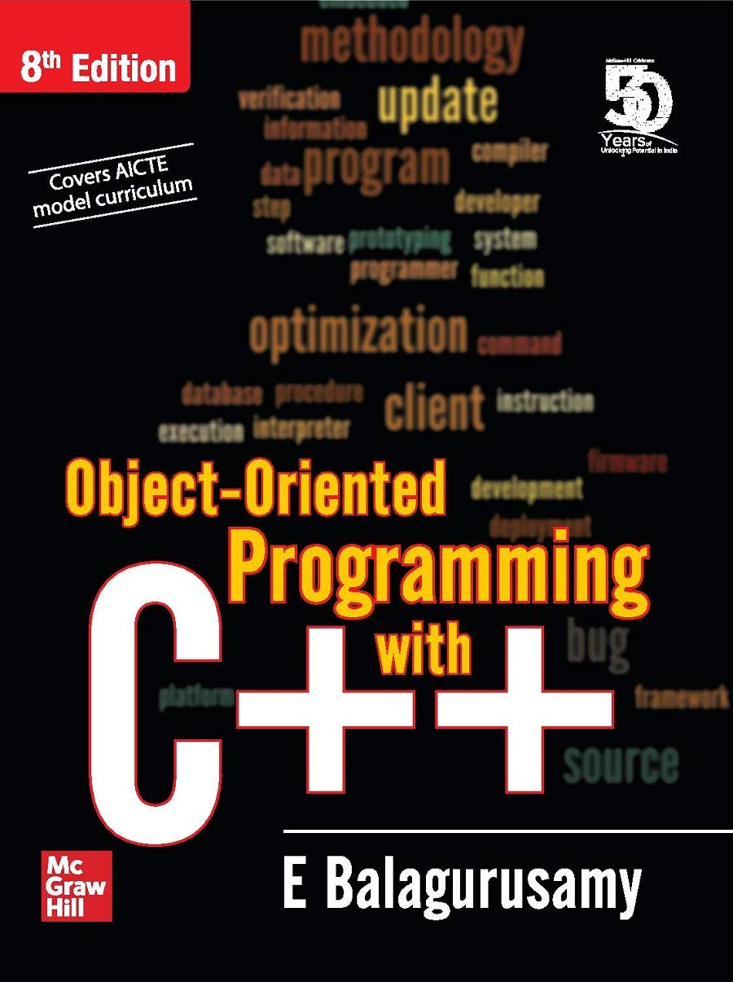
Recommended Books: 1. E.Balagurushamy : “Programming with ANSI C” 2. E.Balagurushamy : “Object-oriented programming with C++” 3. Y. Kanitkar : “Let Us C” 4. H. Schildt : "Teach yourself C". 5. H. Schildt : "C: The Complete Reference". 6. Y. Kanitkar : “Pointers in C” 7. Kernighan & Ritchie : “The C programming language” 8. R. G. dromey : "how to solve it by Computer"

Slide 7
3
CIT-112
CIT 112 Computer Fundamentals and Programming with C/C++ Sessional 3 Hrs. per week 1.5 Credits Sessional works based on CIT 111

Slide 8
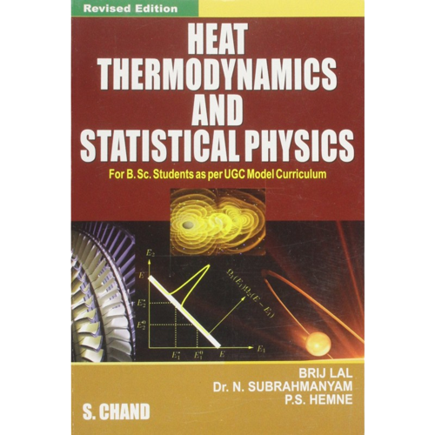
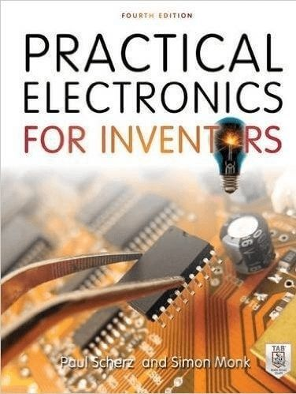
4
PHY-111
Course-1 Title: Physics 1 Course Code: PHY 111 Credit: 3.00 Contact Hour: 3 per week
RECOMMENDED BOOKS AND PERIODICALS
Kinetic theory of gases
Heat and Thermodynamics
Simple Harmonic Motion
Wave motion
Sound waves
Acoustics
Electrostatics

Slide 9
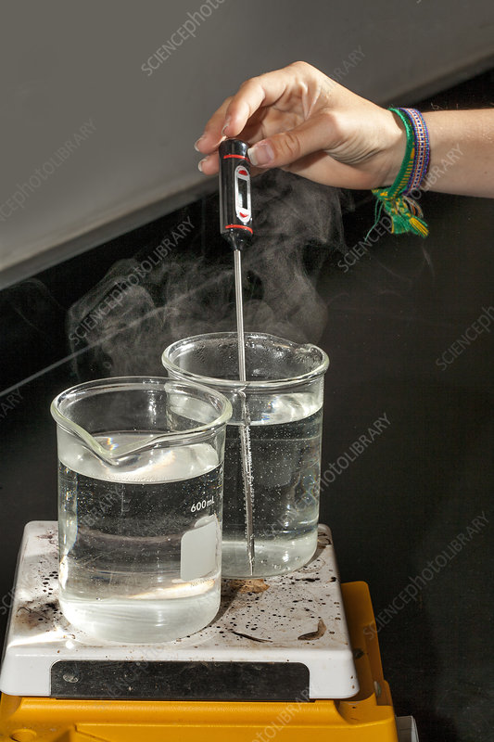
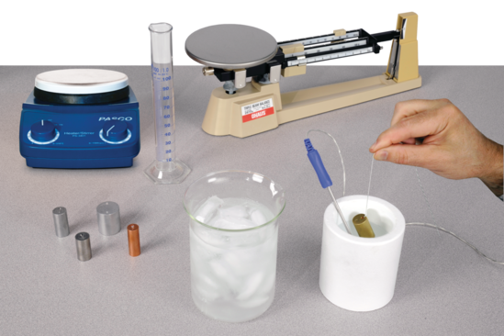
5
PHY-112
Course-2 Title: Physics 1 Sessional Course Code: PHY 112 Credit: 0.75 Contact Hour: 1 per week
Heat and Thermodynamics
Simple Harmonic Motion
Wave Motion
Sound Waves

Slide 10
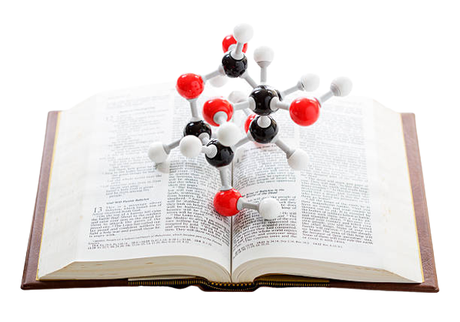
6
CHE-111
Course-3 Title: Chemistry Course Code: CHE 111 Credit: 3.00 Contact Hour: 3 per week
11.1 Rationale: A computer scientist or engineer may choose to be expert in cheminformatics or computational chemistry. Therefore, he or she should have a sound knowledge and deep understanding of chemistry.
Tropic:
Atomic structure, quantum numbers, electronic configuration
Thermo chemistry, chemical kinetics, chemical equilibrium, Ionizations of water. and pH concept
Electrical properties of solutions
Phase rule, phase diagram of mono component system.

Slide 11

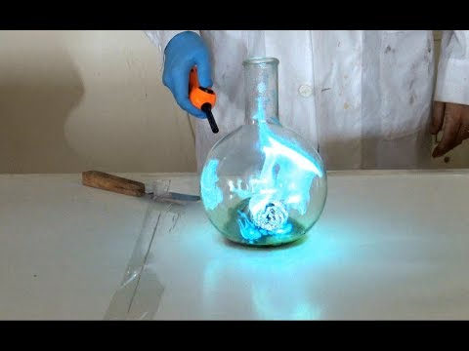
7
CHE-112
Course-4 Title: Chemistry Sessional Course Code: CHE 112 Credit: 0.75 Contact Hour: 1 per week
11.1 Rationale: A computer scientist or engineer may choose to be expert in cheminformatics or computational chemistry. Therefore, he or she should have a sound knowledge and deep understanding of chemistry.
Tropic:
Atomic structure, quantum numbers, electronic configuration
Selective organic reactions, Different types of solutions and their compositions. Properties of dilute solutions
Electrical properties of solutions

Slide 12
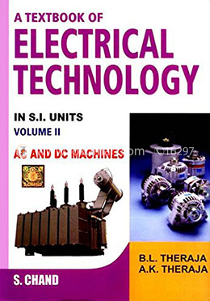
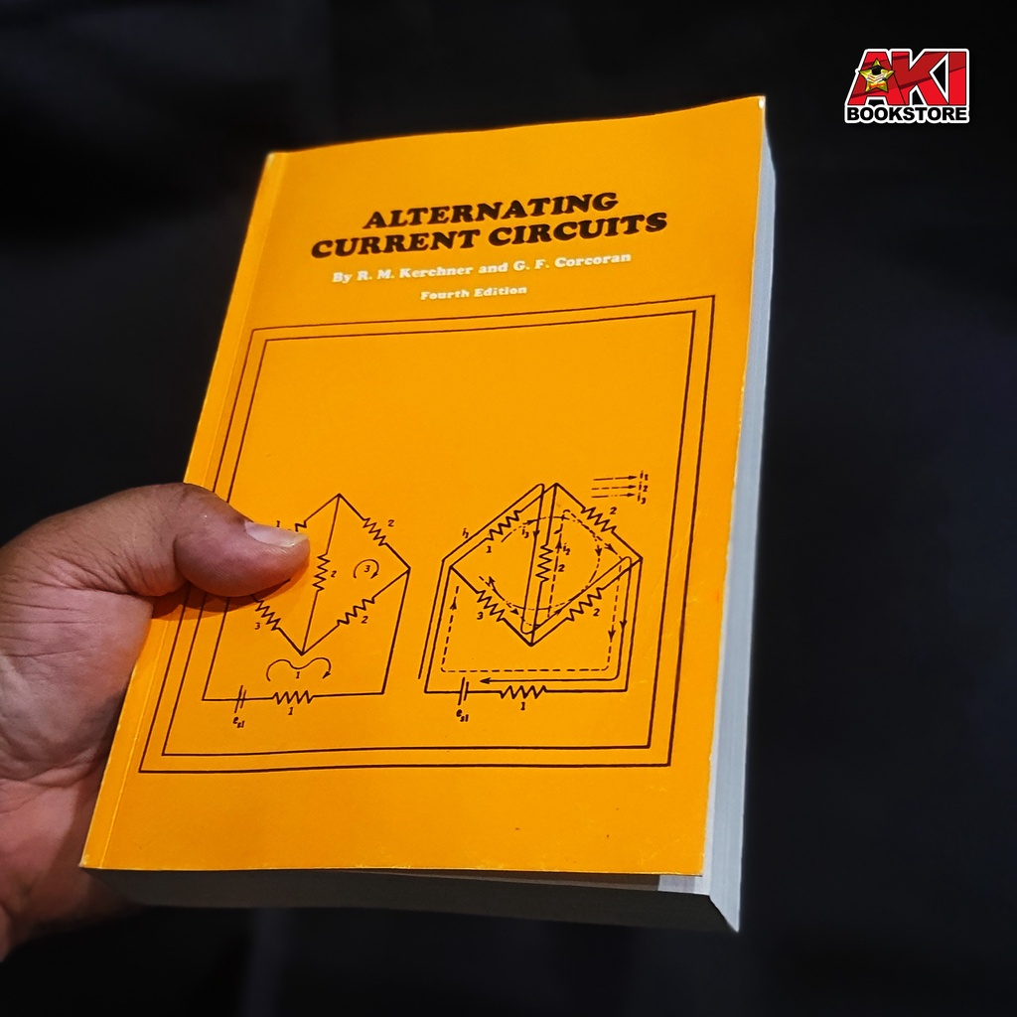
8
EEE-111
Course – 6 Title: Basic Electrical Engineering Course No.: EEE 111 Credit : 3 Contact Hours: 3
10.1 Rationale: To be a computer engineer, one needs to study and apply electricity and electromagnetism in different electrical applications.
Recommended Books: 1. B.L. Theraja : A text book of Electrical Technology, Volume: I 2. V.K. Mehta : Principles of Electrical Engineering and Electronics 3. G.F. Corcoran : Alternating Current Circuits

Slide 13
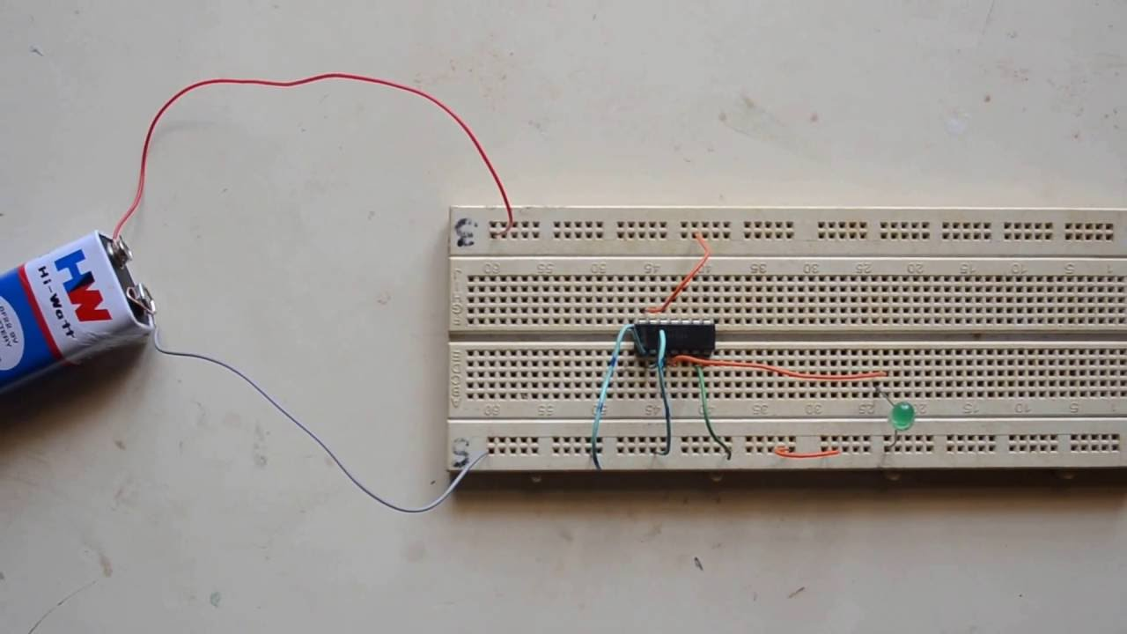
9
EEE-112
Course-7 Title: Basic Electrical Engineering Sessional
Course No.: EEE 112 Credit : 1.50 Contact Hours: 3
11.1 Rationale: To be a computer engineer, one needs to practically apply electricity and electromagnetism in different electrical applications.
Tropic:
Thevenin’s theorem, Norton’s theorem, superposition theorem, Reciprocity theorem, Maximum power transfer theorem
Familiarization with different electrical components and measuring instruments.
series circuit, Parallel circuit and series parallel circuit.
Ohm’s law, kirchhoff’s law

Slide 14
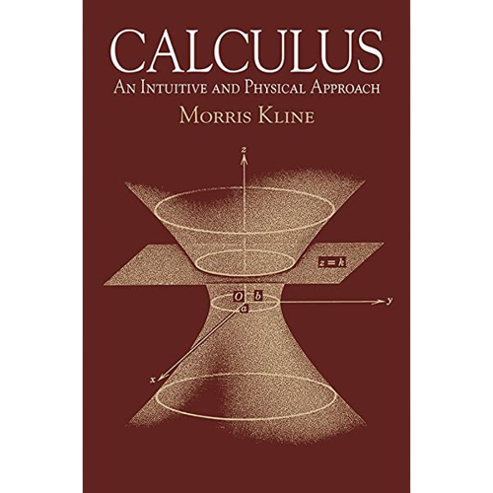
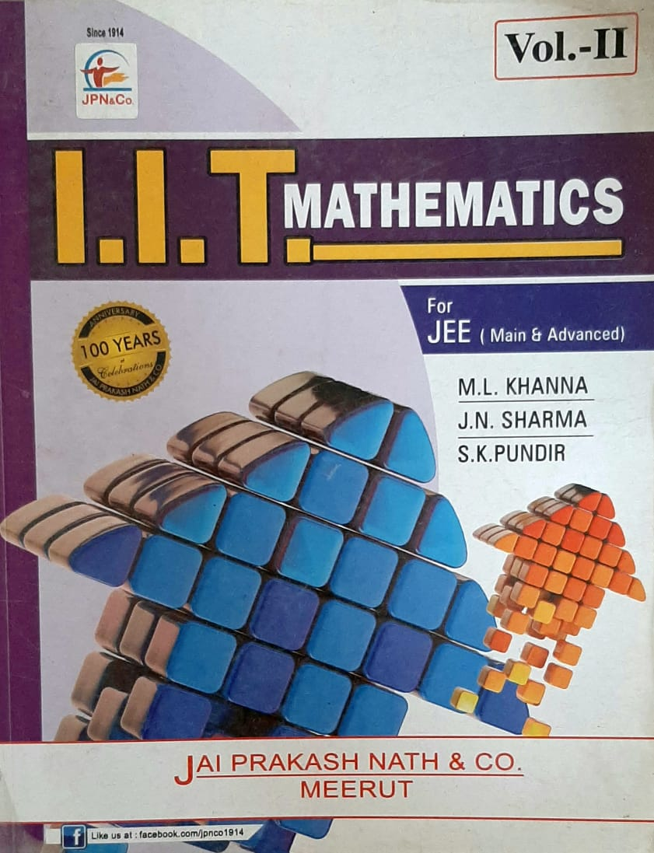
10
ME-111
MAT 111 Mathematics-I Course Content 3.00
Tropic:
Differential Calculus:
Matrix:
Co-ordinate Geometry :
Difference Equations:
Reference Books: 1. S.P. Gordon : Calculus and the Computer. 2. L.I. Holder : Calculus and Analytic Geometry. 3. J.F. Hurley : Calculus

Slide 15
THANK YOU EVERY BODY
FOR WHATCHING MY PRESENTATION.

